Slide 1
Face Recognition Attendance System Based on Real-Time Video Processing
Project Supervisor:
Mrs.M.Anusuya,(B.E,M.B.A,M.Tech)
ASSISTANT PROFESSOR.
Presented By:
B.Barath
G.Sabaraishwaran

Slide 2
Abstarct
The project aims develop an automated attendance system using face recognition technology.
It utilizes a Raspberry Pi board, camera module, and advanced image processing techniques to detect and recognize faces in real-time. Attendance data is stored in a database which is excel sheet.

Slide 3
Motivation
Traditional attendance systems rely on manual methods like roll calls or RFID cards, which are time-consuming and prone to errors. This project aims to automate attendance marking using face recognition, ensuring efficiency, accuracy, and security.

Slide 4
Base Paper Details
Title: Automated Face Recognition for Attendance Tracking
Journal Name: IEEE
Publication date: 15 JANUARY 2024
Author Name: Xiaofeng Han
4

Slide 5
PROBLEM STATEMENT
Key Challenges:
Ensuring high accuracy in varied lighting and background conditions.
Differentiating between similar faces and handling facial changes (glasses, facial hair, etc.).
Maintaining privacy and data security.
Reducing processing time for real-time use.

Slide 6
Objectives:
Build a face detection and recognition system using deep learning models (e.g., OpenCV, Dlib, FaceNet).
Create a secure backend to store attendance data.
Design a user-friendly interface for administrators to manage users and view logs.
Ensure the system is scalable and performs well in real-world environments.

Slide 7
Scope with solutions
Real-Time Video Processing
Capture continuous video feed via webcam or CCTV.
Detect and recognize faces in real-time with minimal delay.
Face Detection and Recognition
Use machine learning models to detect faces from live video.
Match detected faces against a database of pre-registered individuals.
Handle real-time variations like lighting, angles, and facial expressions.

Slide 8
Automatically log attendance when a registered face is recognized.
Attendance Logging
Automatically log attendance when a registered face is recognized.
Prevent duplicate attendance within a time window.
Save data to a secure local or cloud-based database.
System Efficiency
Optimize for low-latency recognition.
Support for multiple users simultaneously in a frame (group detection).
Scalable to classrooms, offices, or public institutions.

Slide 9
Expected Outcomes
What problem this project is trying to solve??
Increased Efficiency in Hiring
More Accurate Candidate Selection
Reduced Manual Workload

Slide 10
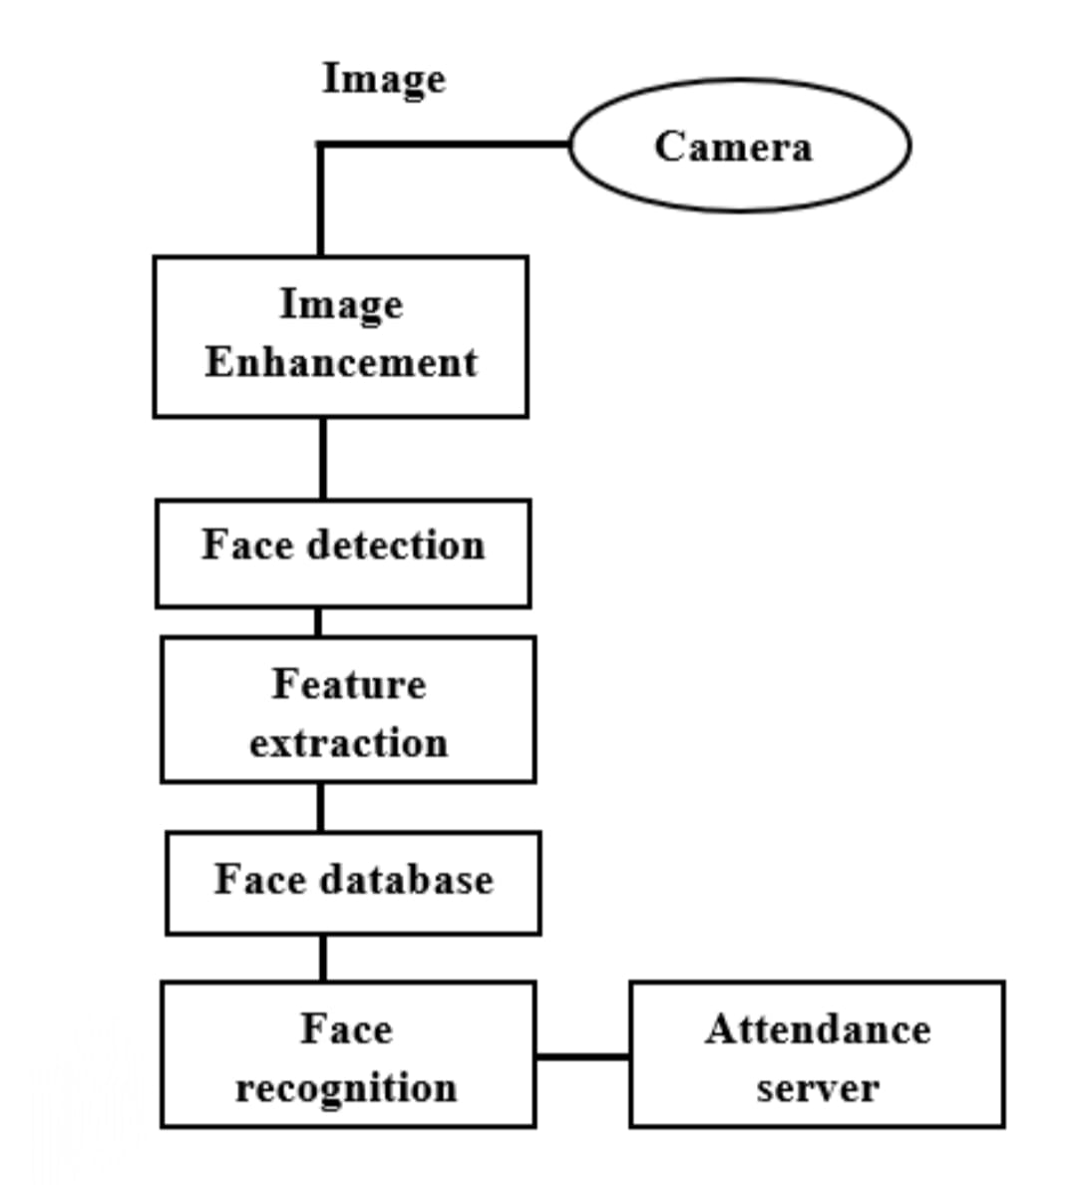
Architecture

Slide 11
Who are the beneficiaries??
Hiring Managers and Recruiters
HR Departments
Job Seekers
Companies and Organizations
Educational Institutions

Slide 12
What Problem This Project is Trying to Solve?
Reducing errors in manual attendance marking
Automating attendance tracking to save time
Enhancing security with real-time facial authentication

Slide 13
Scope for Viability
Current Technology Landscape: AI-powered facial recognition integrated with real-time video processing.
Data Security Measures: Secure database storage with encryption and access control.
User Education: Training programs for faculty and employees on system usage.

Slide 14
Problem Identified
Why is there a Need to Solve it?
Manual attendance marking is inefficient and error-prone.
Proxy attendance and identity fraud are common issues.
Real-time attendance tracking can improve operational efficiency.

Slide 15
Problem Identified
How Do You Manage to Solve It?
Implementing a face recognition model to detect and verify individuals.
Automating attendance recording in real time.
Integrating with databases for seamless attendance management.

Slide 16
HARDWARE AND SOFTWARE
1. Camera (Webcam or IP Camera).
2. Processor/Computer.
3 . Face Recognition Algorithm:
1. Display Screen (optional).
2. Database System:
3. User Interface (UI):

Slide 17
Thank you

